Slide 1
DIRECTORY SERVICES
LDAP

Slide 2
Network is responsible for transmission of data from one device to another device.
Data can be corrupted during transmission.
Error control is the process of detecting and correcting both the bit level and packet level errors.
Types of Errors
Single Bit Error
Multiple bits error
Burst Error
Error control mechanism may involve two possible ways:
Error detection
Error correction
Error detection is the process of detecting the error during the transmission between the sender and the receiver.
Types of error detection
Parity checking
Cyclic Redundancy Check (CRC)
Checksum

Slide 3

Parity checking
Types of Parity Checking
Single bit parity
Two dimension parity
Single bit parity:
One extra bit is sent along with the original bits to make number of 1s either even in case of even parity, or odd in case of odd parity.
Two dimension parity
Parity check bits are calculated for each row, which is equivalent to a simple parity check bit. Parity check bits are also calculated for all columns, then both are sent along with the data. At the receiving end these are compared with the parity bits calculated on the received data.

Slide 4
Cyclic Redundancy Check (CRC):
CRC is a different approach to detect if the received frame contains valid data. This technique involves binary division of the data bits being sent.
The divisor is generated using polynomials.
Before sending the actual bits, the sender adds the remainder at the end of the actual bits.
Actual data bits plus the remainder is called a codeword.
Checksum:
In checksum error detection scheme, the data is divided into k segments each of m bits.
In the sender’s end the segments are added using 1’s complement arithmetic to get the sum. The sum is complemented to get the checksum.
The checksum segment is sent along with the data segments.
At the receiver’s end, all received segments are added using 1’s complement arithmetic to get the sum. The sum is complemented.
If the result is zero, the received data is accepted; otherwise discarded.

Slide 5
Error Correction
In the digital world, error correction can be done in two ways:
Backward Error Correction :
When the receiver detects an error in the data received, it requests back the sender to retransmit the data unit.
Forward Error Correction :
When the receiver detects some error in the data received, it executes error-correcting code, which helps it to auto-recover and to correct some kinds of errors.

Slide 6
Addressing
Data-link layer provides layer-2 hardware addressing mechanism. Hardware address is assumed to be unique on the link. It is encoded into hardware at the time of manufacturing.
Flow Control
When a data frame (Layer-2 data) is sent from one host to another over a single medium, it is required that the sender and receiver should work at the same speed. That is, sender sends at a speed on which the receiver can process and accept the data. What if the speed (hardware/software) of the sender or receiver differs? If sender is sending too fast the receiver may be overloaded, (swamped) and data may be lost.

Slide 7
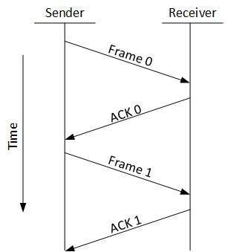
Two types of mechanisms can be deployed to control the flow
Stop and Wait:
This flow control mechanism forces the sender after transmitting a data frame to stop and wait until the acknowledgement of the data-frame sent is received.

Slide 8
Sliding Window
In this flow control mechanism, both sender and receiver agree on the number of data-frames after which the acknowledgement should be sent. As we learnt, stop and wait flow control mechanism wastes resources, this protocol tries to make use of underlying resources as much as possible.

